Slide 1
오라클 – 백앤드 자동화 준비 설정 노트

Slide 2
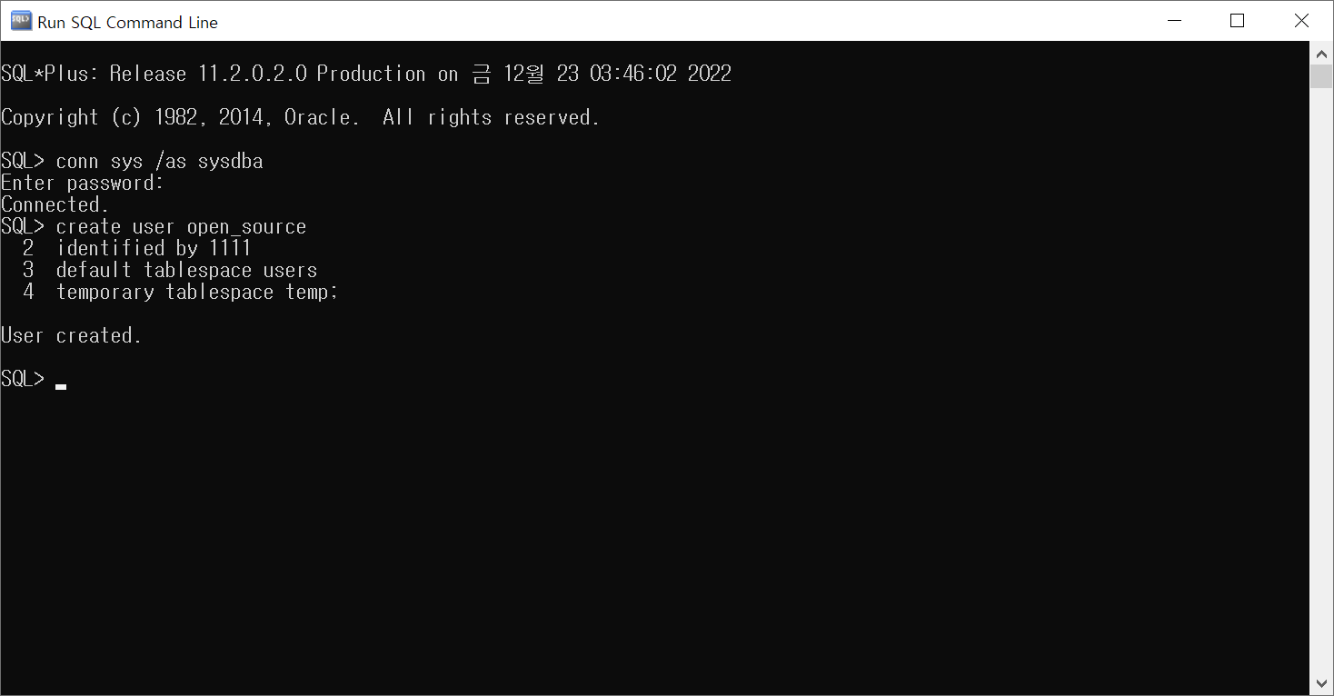

Slide 3
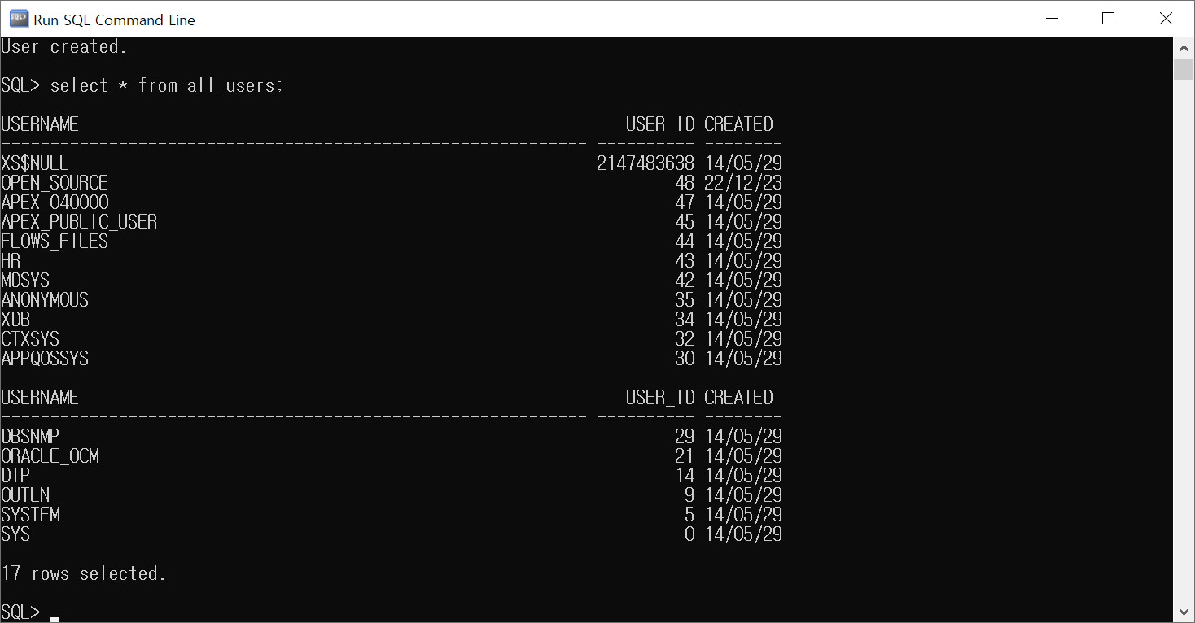

Slide 4
SQL> grant connect to open_source;
Grant succeeded.
SQL> grant resource to open_source;
Grant succeeded.
SQL> grant dba to open_source;
Grant succeeded.

Slide 5
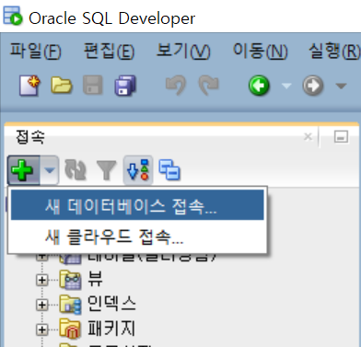

Slide 6
